Slide 1

And now selenium’s watch is ended
Using Cypress to write UI tests that are less brittle and run faster
Matthew Knowles
Software Craftsman at Greater Sum
www.GreaterSum.com
@MatthewYKnowles
Matthew@GreaterSum.com

Slide 2
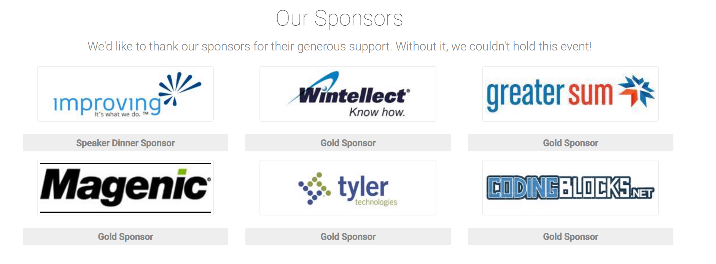
Atlanta Code Camp 2019

Slide 3
What we will talk about
Tests
Testing with Selenium
Testing with Cypress
Live coding Cypress tests
Advanced UI testing techniques
Notes:
Goal of the talk is to breakdown any friction from preventing you from going out and writing some tests against your professional project or even personal projects

Slide 4
Why do you write tests?

Slide 5
Why Write Tests?
Verify functionality
Defend against unexpected change
Executable documentation of the code

Slide 6
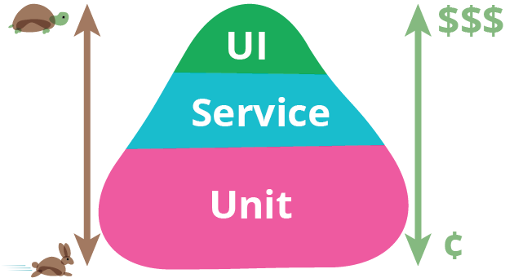
https://martinfowler.com/bliki/TestPyramid.html
Notes:
Today I am going to focus on three separate types of tests: UI, Integration (Service), and Unit Tests. The picture you see is of the automated testing pyramid. It describes the composition of tests that you would like to have make up your automated test suite. We will get more into what these different tests mean in a little bit but the important takeaway is that UI tests are extremely slow and expensive while unit tests are very quick and cheap. Money is a representation of time to write and time to maintain Some of you might be wondering why is it called a pyramid when it is clearly a triangle? Well that’s a great question… but googling for testing pyramid will give you a lot of great results on the types and ratios of automated tests you should write. My guess is they want the ratio to have some depth to it. Like your unit tests physically support your integration and UI tests.

Slide 7
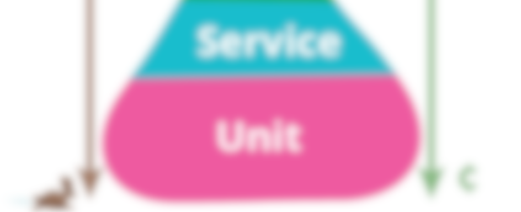
https://martinfowler.com/bliki/TestPyramid.html
Notes:
Today I am going to focus on three separate types of tests: UI, Integration (Service), and Unit Tests. The picture you see is of the automated testing pyramid. It describes the composition of tests that you would like to have make up your automated test suite. We will get more into what these different tests mean in a little bit but the important takeaway is that UI tests are extremely slow and expensive while unit tests are very quick and cheap. Money is a representation of time to write and time to maintain Some of you might be wondering why is it called a pyramid when it is clearly a triangle? Well that’s a great question… but googling for testing pyramid will give you a lot of great results on the types and ratios of automated tests you should write. My guess is they want the ratio to have some depth to it. Like your unit tests physically support your integration and UI tests.

Slide 8
Why Write UI/E2E Tests
Exercise your code in a live or live like environment
Verify that all components are connected correctly
Human Readable
Behavior Driven Development (Dev/Product/Test)
Acceptance Test
Signifies completion of a feature
Legacy code
Notes:
Behavior Driven Development is a methodology that encapsulates a lot but one of the core tenants is having a representative from product, dev, and test get together and come up with acceptance tests that flush out a feature. Today we are going to start writing our app with a failing acceptance test that when passing signifies that we have implemented the functionality that the product owner requested.

Slide 9
Selenium to Cypress in a project

Slide 10
Project’s Selenium Test Suite
Tests were flaky
Tests were difficult to debug when they broke
Very difficult to discover what went wrong if failed in CI
Writing a new test took a fair amount of time
UI/E2E Test suite ran in about 18 minutes
Could use Port on machine to verify emailed information

Slide 11
Project’s Cypress Test Suite
Tests are a lot less flaky
Finding out why a test failed is a lot easier (pictures, videos, DOM snapshot)
Much easier to diagnose failures in CI
Writing new tests did not take as long
UI/E2E Test suite ran in about 10 minutes (vs ~18 for Selenium)
Could no longer use port to verify information sent over email

Slide 12
Intro to Cypress

Slide 13
Why not to use Cypress
Firefox, Safari, and Edge
Use non browser ports on the machine its running on
Has been out of beta less than 1 year

Slide 14
Write some tests against code camp website

Slide 15
Write some tests against Connect Four

Slide 16
Page Object Pattern

Slide 17
Whatever you would manually test try and automate
Notes:
Where you can start.
How will we know what we’ve made changes correctly?
How will we know that we haven’t broken anything?

Slide 18
Starting with a failing Acceptance Test focuses your code on value
Notes:
You only write the code that you need to dulfill th

Slide 19
Conclusions

Slide 20
Questions?
@MatthewYKnowles
Matthew@GreaterSum.com

